Slide 1

SIMPLILEARN PROJECT-4 HOSPITAL MANAGEMENT SYSTEM-MAYO CLINIC G.RAJASHEKAR

Slide 2
TABLE OF CONTENT
INTRODUCTION
STAKEHOLDERS
PROPOSED SYSTEM WORKFLOW
PROJECT SCOPE
USE CASE DIAGRAM
MAIN FEAUTURES TO BE DEVOLOPED
ENTITY RELATIONSHIP DIAGRAM
DATAFLOW DIAGRAM
FUNCTIONAL REQUIREMENTS AND NON FUNCTIONAL REQUIREMENTS
FLOWCHART FOR PATIENT REGISTRATION PROCESS
MOCK SCREEN

Slide 3
Identifying stakeholders
Internal stakeholders
External stakeholders
Patient
Staff
Doctors
Lab
Medicine in charge
System administrator
Invoice and bills staff
Business analyst
Supplier
Project manager
Implementation sme
Operational team
Developer
Tester

Slide 4
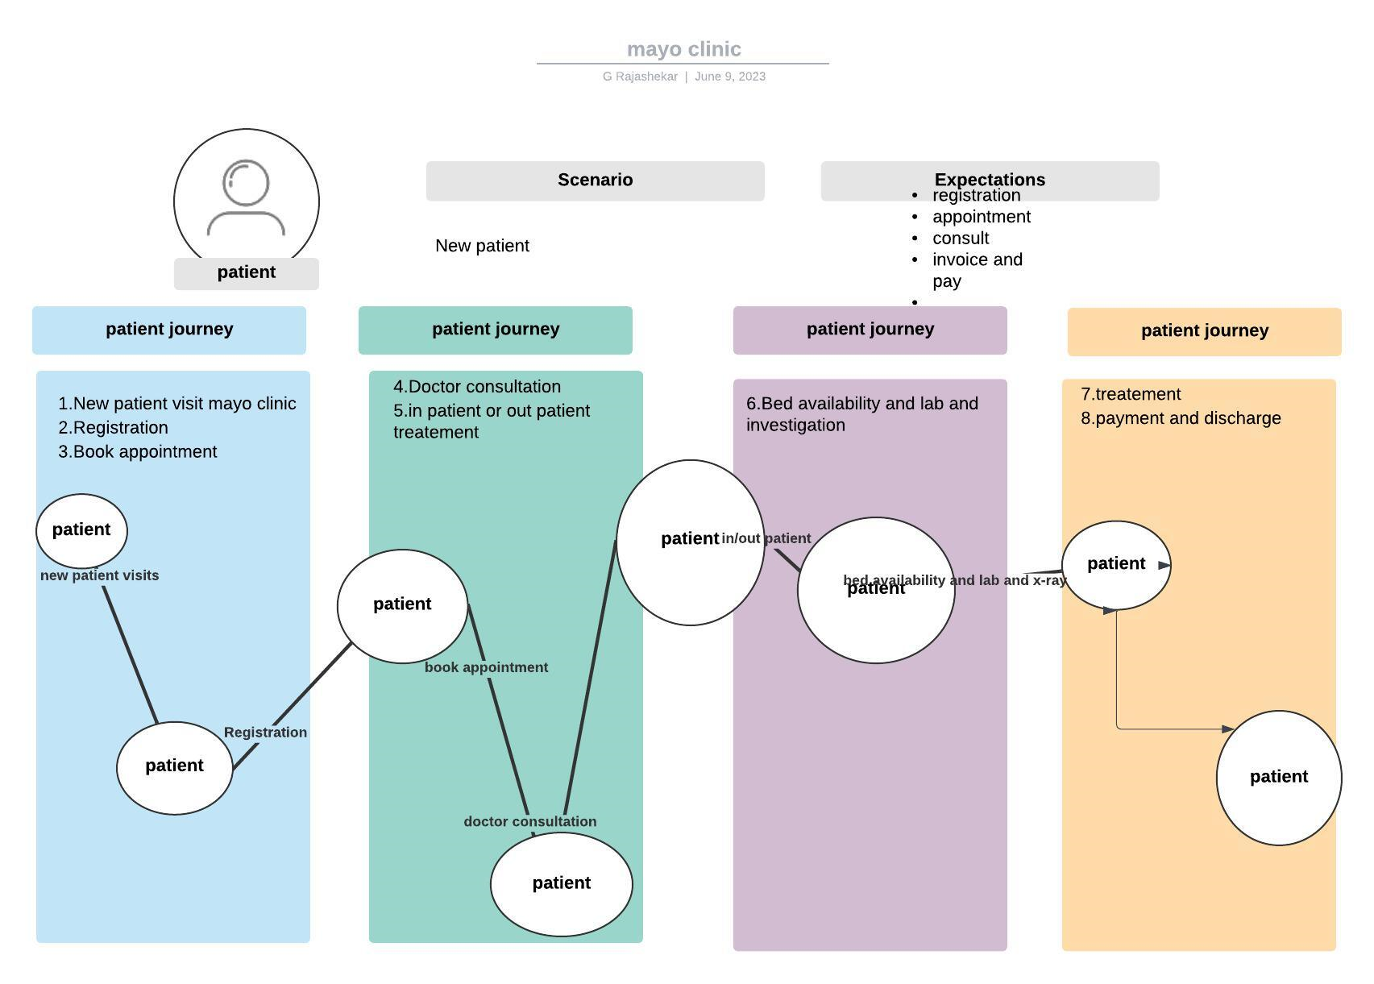
Patient process workflow

Slide 5
In-scope and out-of-scope items for this software
In Scope Requirements | Out Of Scope requirements
Appointment Scheduling | Emergency department (ICU, Ventilators, Oxygen tanks, Beds etc.)
Appointment reminders | Hospital payroll management
Patient registration | Visitor log
Add / delete / update/ maintain patient’s record | Medical staff’s details
Order medical prescription
Order lab tests and lab test results
Patient admission
Bed occupancy management
Staff (nurses and ward boys) management
Report generation
Billing and Insurance

Slide 6
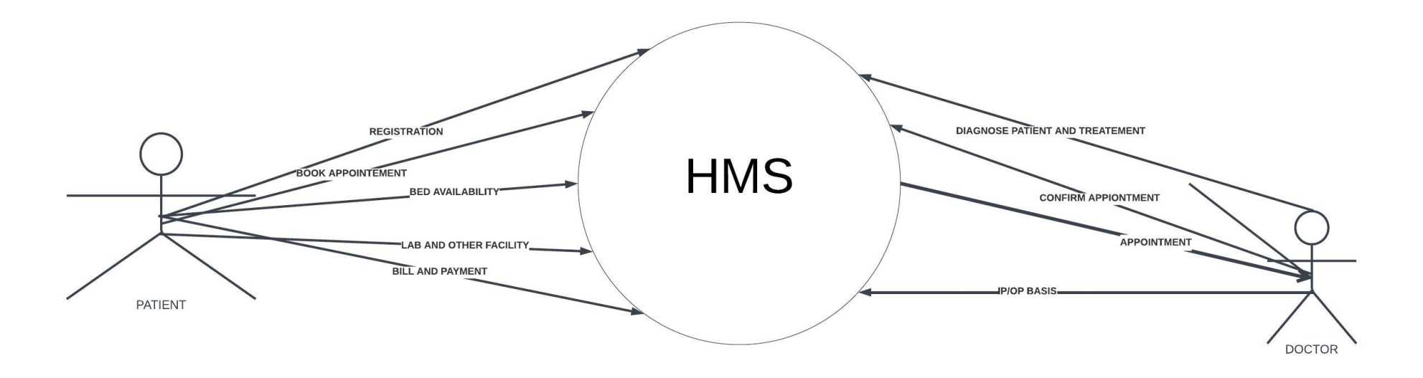
SCOPE OF HMS
The scope of the hospital management system has 5 components: Patient, Registration staff, Doctors and Nurses, Lab and radiation department, Hospital management and Billing

Slide 7
Main features to be devoloped
Patient registration
Patient appointment management
Booking appointment with required doctor or available doctor
Able to look bed availability and other facility's and to book
Labs and blood bank and other requirements should visible in system
Reports of all investigation
Billing and payment

Slide 8
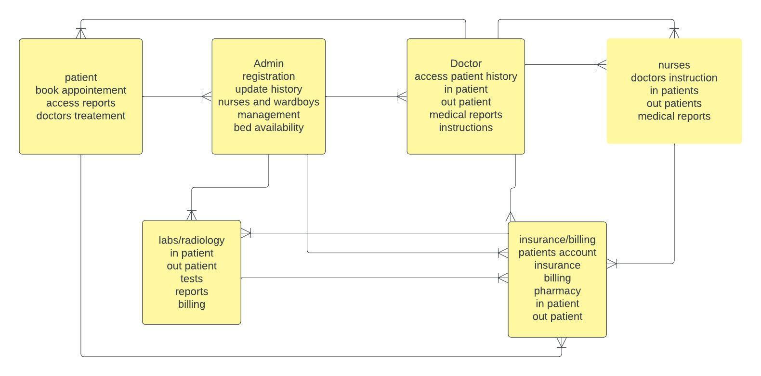
HMS ENTITY RELATIONSHIP DIAGRAM

Slide 9
Functional and Non functional requirements

Slide 10
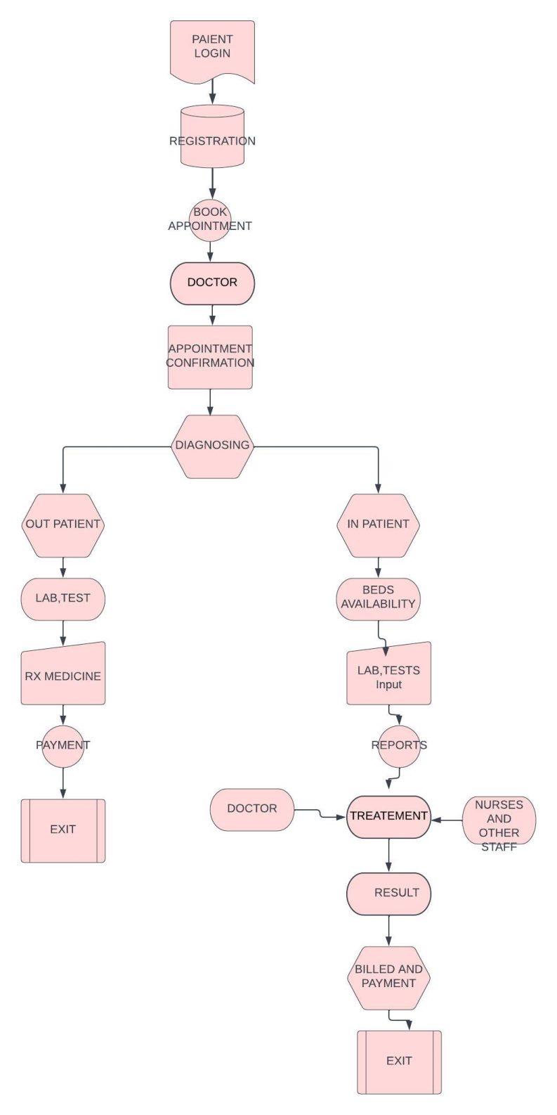
DATA FLOW DIAGRAM FOR HMS

Slide 11
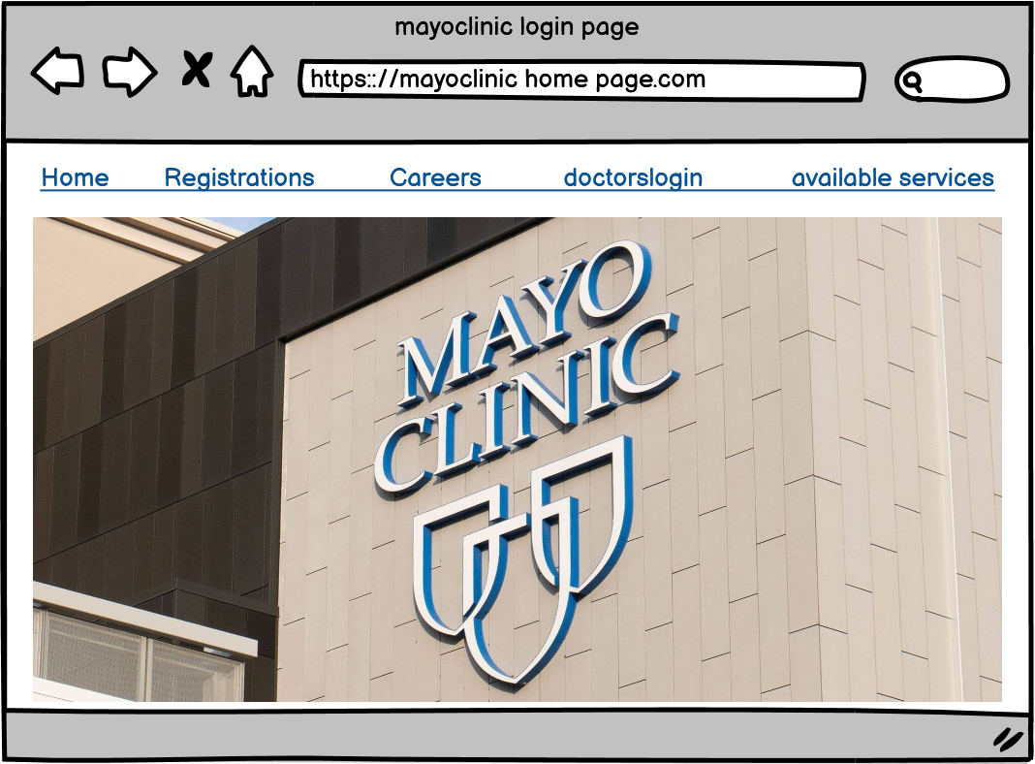
Mayo clinic home page

Slide 12
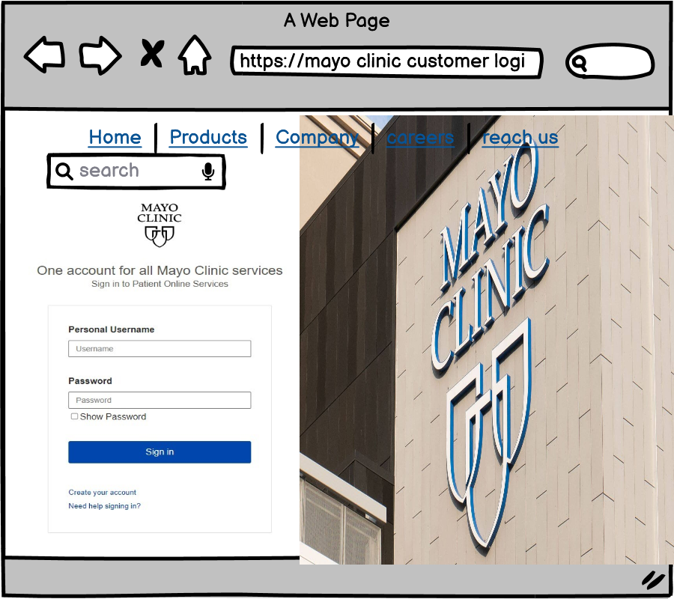
Mayo clinic patient login page

